Slide 1


FAKE NEWS PROJECT
Submitted by
KUNIGIRI NAGARAJU

Slide 2
INTRODUCTION
Fake News contains misleading information that could be checked. This maintains lie about a certain statistic in a country or exaggerated cost of certain services for a country, which may arise unrest for some countries like in Arabic spring. There are organizations, like the House of Commons and the Crosscheck project, trying to deal with issues as confirming authors are accountable. However, their scope is so limited because they depend on human manual detection, in a globe with millions of articles either removed or being published every minute, this cannot be accountable or feasible manually. A solution could be, by the development of a system to provide a credible automated index scoring, or rating for credibility of different publishers, and news context

Slide 3
Data Sources and their formats
There are two csv datasets namely “fake” with 23481 samples and “real” with 21417 samples which were merged into a dataset for our model building.
The dataset includes columns such as ‘title’, ‘subject’, ‘text’, ‘date’ and ‘target’
Notes:
Focus on ongoing hot issues
Covid-19, in 2020 the unknowns of the virus allowed people speculate and spread false information
Trump vs Hilary Clinton/Biden Campaign, these two political races were trending topics and easy target to falsify information for political gain
Russia vs Ukraine War
Focus on concepts that are important to specific populations or topics of interest
Political views, humans tend to believe point of views they align with for example if someone aligns with the Republicans they tend to believe there representatives vs a Democratic representative
Religious views, similarly to political views humans will believe information they have faith in, for example the text from the Bible, Quran, etc.
Lack of education or training on verifying sources, if people aren't informed to verify and practice verifying they will never validate information they receive

Slide 4
Data Preprocessing
First we check the information of the given dataset because it tells that how many rows and columns are present in our dataset and data type of the columns whether they are object, integer or float.
Dropping duplicates rows if present in dataset.
Then we check for the null values present in our dataset. If null values are present then drop it because we cannot able to fill the text data.
After that we check the summary statistics of our dataset. This part tells about the statistics of our dataset i.e. mean, median, max value ,min values and also it tell whether outliers are present in our dataset or not.
We also check the correlation of our target features with each other. If columns are highly correlated with each other let’s say 90% or above then remove those columns to avoid multicollinearity problem
We also create new columns to check the length of data before cleaning the Input feature column.

Slide 5
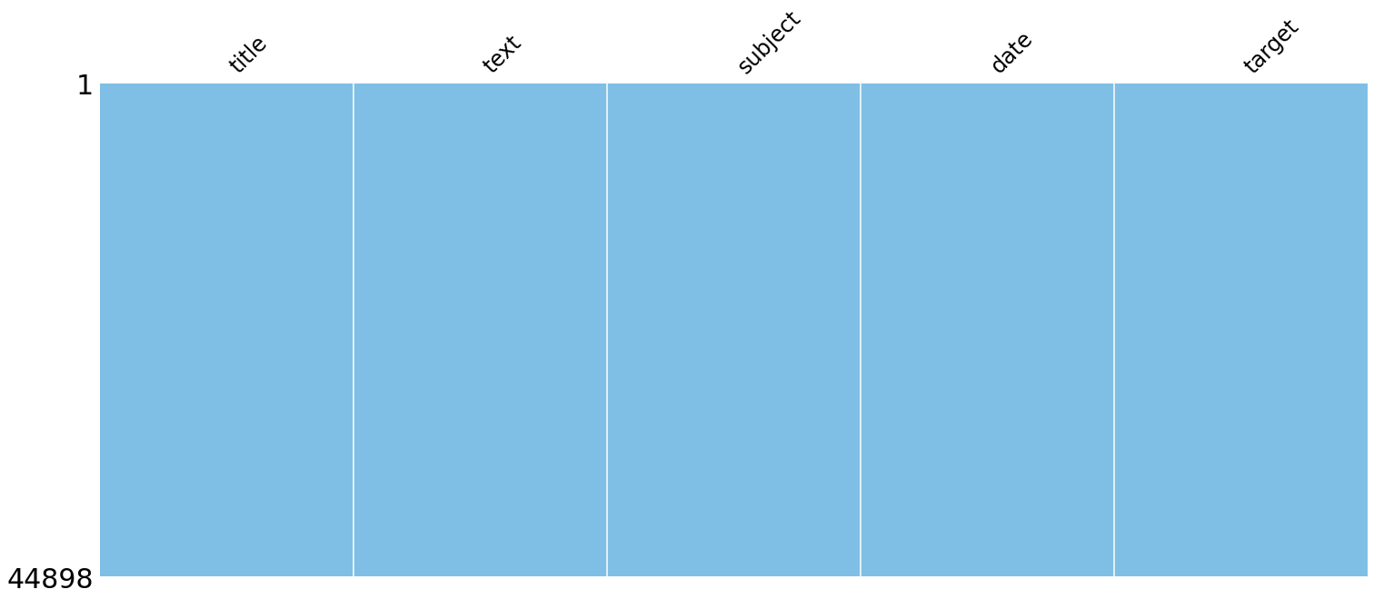
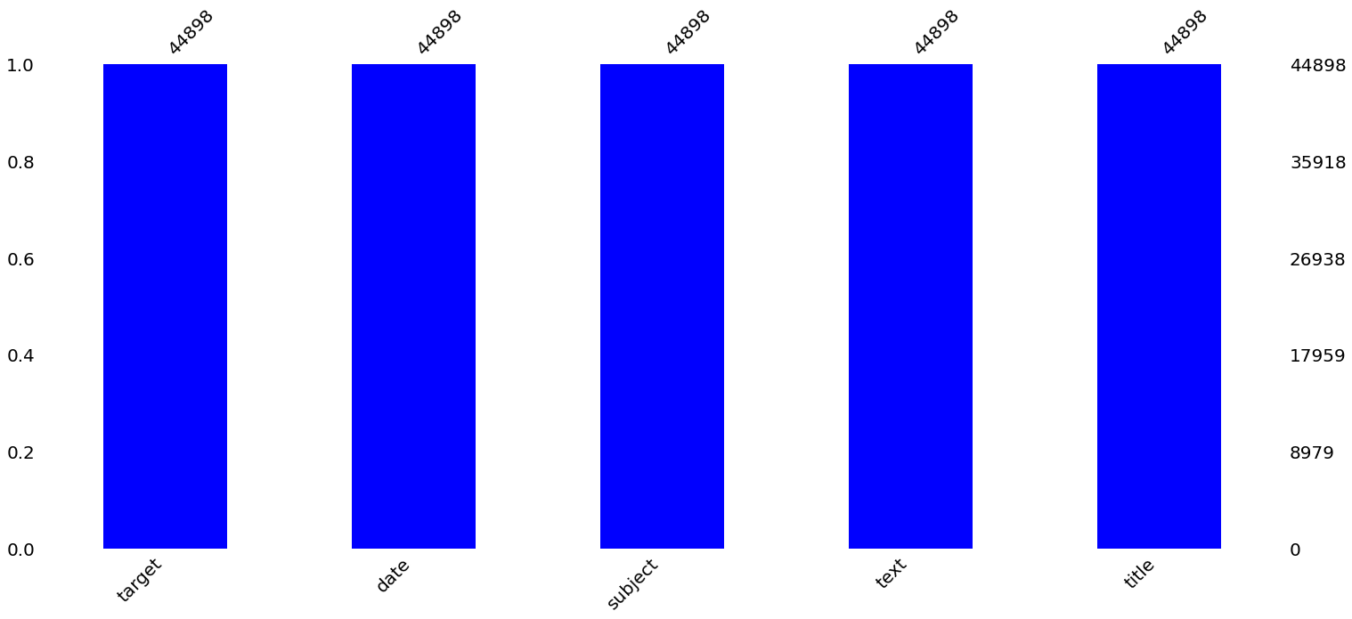
Data Visualization

Slide 6
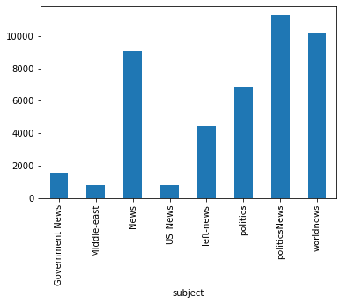
Data Visualization
As per the graph Political news and world news articles are more

Slide 7
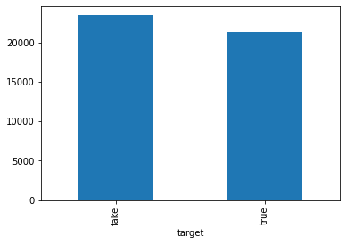
Data Visualization
As per the graph there are 23481 fake articles and 21417 articles in the dataset

Slide 8
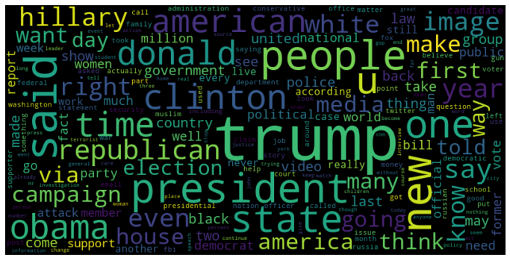
Data Visualization
wordcloud for fake news articles

Slide 9
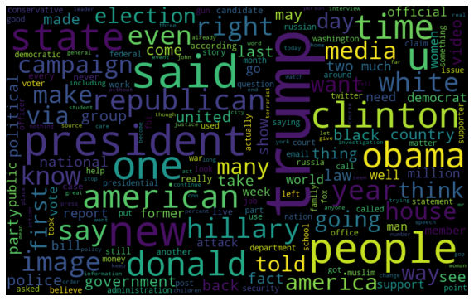
Data Visualization
wordcloud for real news articles

Slide 10
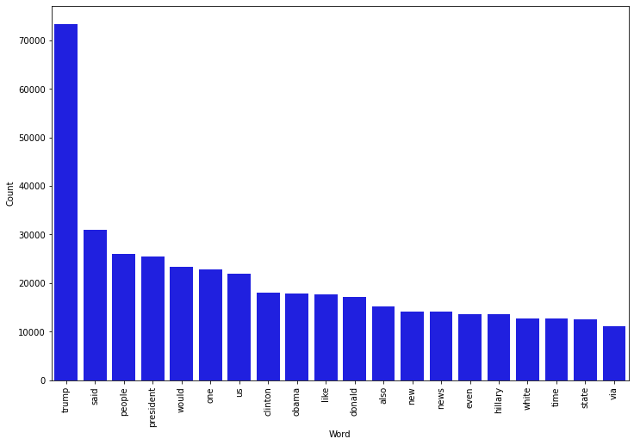
Data Visualization
Morethan 70000 times "trump" is the most frequent word used in the fake news articles and the words are trump,said,people,president,would,one,us,Clinton,Obama,like,Donald,also,news,even,hilary,white,time,state and via etc…

Slide 11
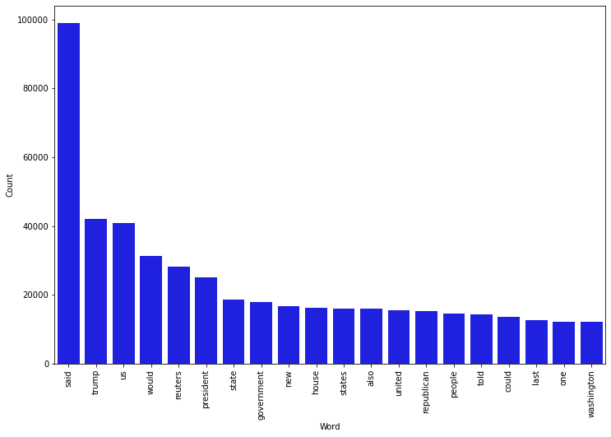
Data Visualization
"said" is the most frequent word used in real news articles

Slide 12
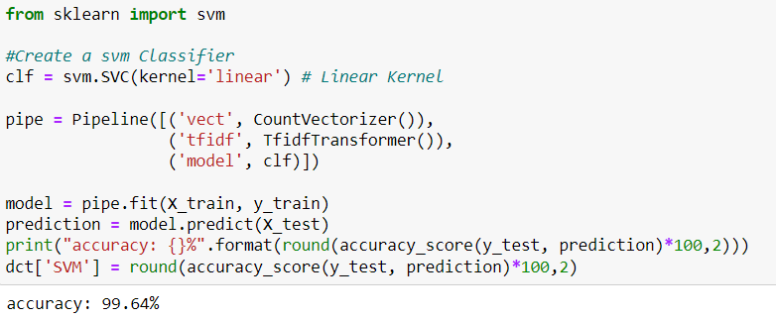
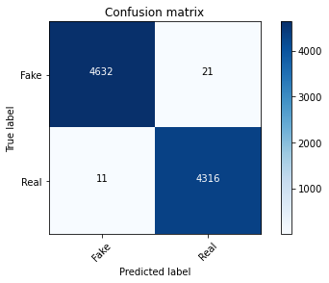
Model Selection
SVM Model gives us the best accuracy of 99.64% by comparing with other models

Slide 13
Conclusion
We have presented a model for fake news detection through different machine learning techniques. Furthermore, the paper investigated the other methods and compared their accuracies. The model that achieves the highest accuracy is SVM and the highest accuracy score is 99.64%. Fake news detection is an emerging research area which has a scarce number of datasets. There are no data on real-time news or regarding the current affairs. The current model is run against the existing dataset, showing that the model performs well against it. In our future work, news article data can be considered related to recent incidents in the corpus of data. The next step then would be to train the model and analyze how the accuracies vary with the new data to further improve it.

